Slide 1
Employee data analysis using the excel
Student Name :jayaraj.s.v
Register no : 312211625
Department :bcomg(commerce)
College : thiruthangal nadar college

Slide 2
Project title
Salary And compensation Analysis Through
Excel data modelling

Slide 3
Agenda
Problem statement
Project overview
End user
Our solution and proposition
Data description
Modelling approach
Result
Discussion
Conclusion

Slide 4
Problem statement
Describe the issue or opportunity
e.g “our organisation lacks a comprehensive
Understanding of its salary and compensation structure leading to potential inequalities and inefficiencies”

Slide 5
Project overview
Summarise the project’s objectives , scope and deliverable ,e.g, “this project aims to develop an excel data model to analyse salary and compensation data , identify trends,and provide recommendations for optimization”

Slide 6
End user
Identify the stakeholders who will benefit from the analysis,e.g HR, management,and employees.

Slide 7
Our solution and proposition
Explain how your excel data model will address the problem,e.g, “our solution will be provide a interactive and dynamic dashboard to visualise salary and composition data enabling data driven decision

Slide 8
Data description
Detail the data sources , types, and variables used,e.g., employee Ids, job titles , salaries, benefits,and performance

Slide 9
Modeling approach
Outline the excel data modeling techniques used, such as:
*Data cleaning and preprocessing
*Pirot tables and data visualization
*Scenario planning and sensitivity.

Slide 10
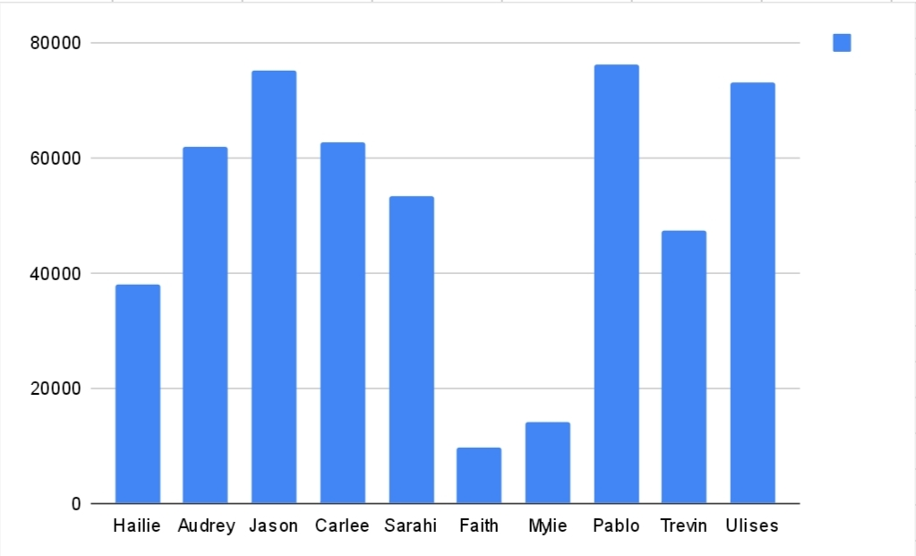
ResuLT IN BAR DIAGRAM

Slide 11
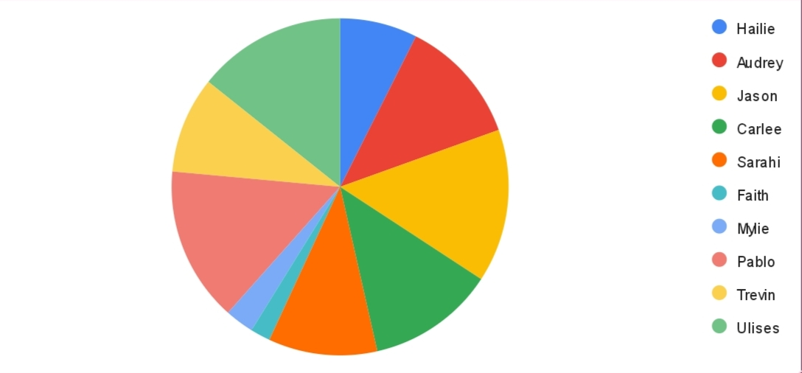
RESULT IN PIE CHART

Slide 12
Disscussion
Interpret the results, highlighting Implications, opportunity,and recommendations for salary and compensation adjustments

Slide 13
Conclusion
This outline should provide a solid structure for your salary and compensation analysis using excel data model.

